Slide 1
Usability Review of Virtual Labs

Slide 2
Usability Review of Virtual Labs
For a Learner
Engineering Students
Profile:
Akash a 2nd year Computer engineering student at MIMIT, Malout Punjab. He is diligent student who likes to learn new things, but finds himself limited by the resources, lack of exposure and interaction with active individuals in the field.
Scenario: First time use
During the introductory class of data structure, Akash is informed in the class about Virtual labs as a supplementary resource to be used during the semester. During the next IT lab session, he decides to check out vlab.co.in.
Motivation: To learn new things and develop a better understanding of concepts.
Goals: To find good study material for Data Structures

Slide 3
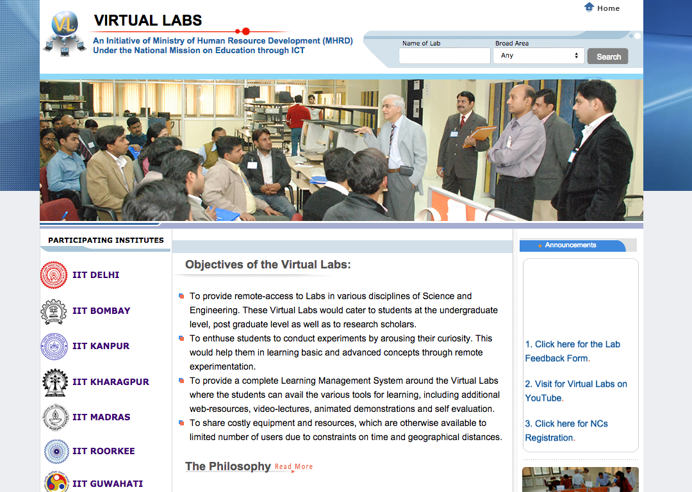
Usability Review of Virtual Labs
For a Learner
Clear title of the website
Clearly indicates who it is by making it credible
2
Critical entry element lost
Search fields are not visible as they are lost in the big image and loud visuals
Even if spotted its unclear what to do with it.
Missing subtitle about what Virtual Lab is about
1
3
What is this?
Objectives text is too dense and fails to convey the offering for the learner
4
What do I do here?
Fails to show the relevant educational material upfront

Slide 4
Usability Review of Virtual Labs
For a Learner
Adds credibility and motivation by listing the best institutes.
6
Irrelevant announcement
Nothing useful and taking attention away from the main content.
How do the institutes help me?
Fails to convey the role of the institutes for a learner.
5

Slide 5
Usability Review of Virtual Labs
For a Learner
9
What is it?
Images of little relevance for learners, lacking focus on lab experience and educational tools.
Distracting moving images.
Images cycle repeatedly distracting users away the main content.
7
10
Scrolling announcements are distracting
Fast scroll makes it difficult to read or take any action.
Visual Clutter
Colourful logos, different colored text. All caps text create a visual clutter making it hard to read.
8

Slide 6
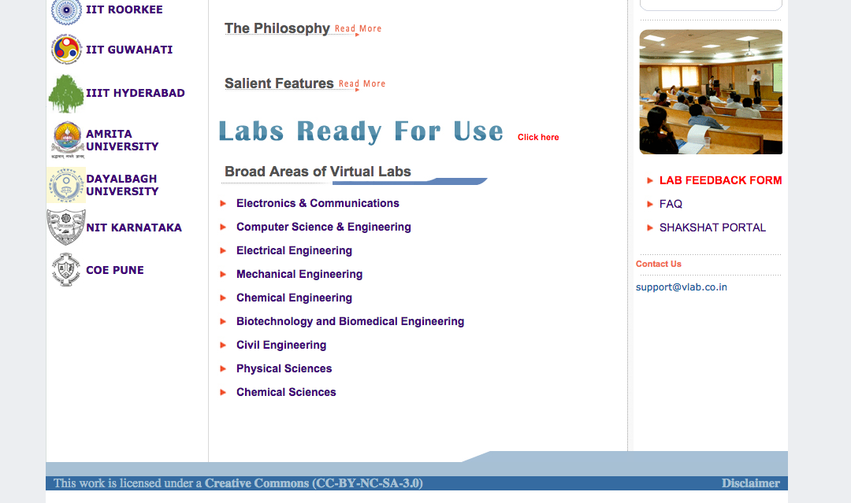
Usability Review of Virtual Labs
For a Learner
Empty elements taking prime real estate.
The Philosophy and Salient features have no content under it, empty space taking up key screen space.
11
12
Distracting moving images
Images cycle repeatedly distracting users away from the main content
13
Distracting blinking link
‘Lab feedback form’ link keeps blinking. It is another distraction from the lab content.

Slide 7
Usability Review of Virtual Labs
For a Learner
Poor location for critical content
The labs for my Computer stream are located at the end of the page.
14
16
Visual clutter
‘Labs ready for use’ has different font, gradient colour and different size. This makes it distracting and difficult to read.
Clear and meaningful categorisation of subjects
Are these two different?
Two overlapping entry points leading to similar content cause confusion.
Only one clear entry point for the labs is required.
15
17
Where to click?
Labels are hyperlinks, the extra ‘Click here’ element leads to confusion.

Slide 8
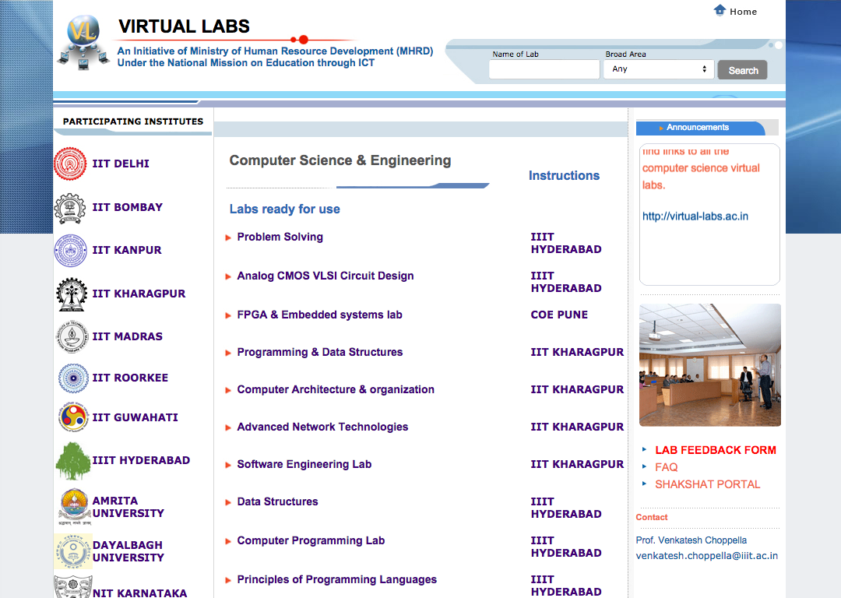
Usability Review of Virtual Labs
For a Learner
20
Poor location of search
Learner will need search near the list of labs, but it gets lost on the top and becomes irrelevant.
No Categorisation of Labs
The labs are just list with no categorisation either by subjects who is it applicable for (2,3 or 4th year students).
User has to just read the list to figure out which is relevant for him. At least alphabetical list will help find the labs.
18
Key content squeezed
The visual clutter on left and the All caps intuitions name on the right visually over power the attention form the main labs.
List of participating institutes is irrelevant on this page.
19

Slide 9
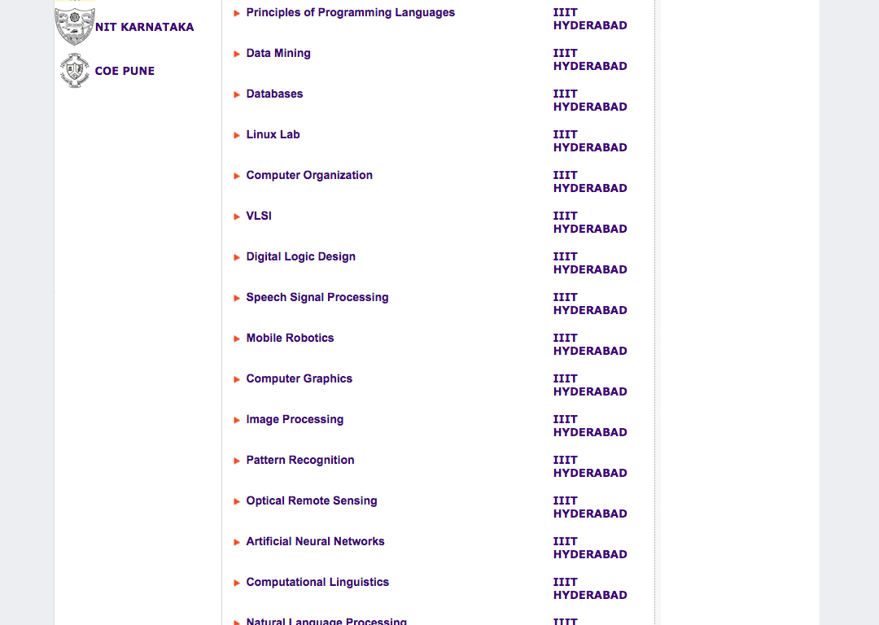
Usability Review of Virtual Labs
For a Learner
Poor grouping of the content
The there is too much space between the name of the Labs and the Institutes name, making it hard to read.
21
Too much spacing between the list of labs
The list takes a longer space as the space between the labs
22

Slide 10
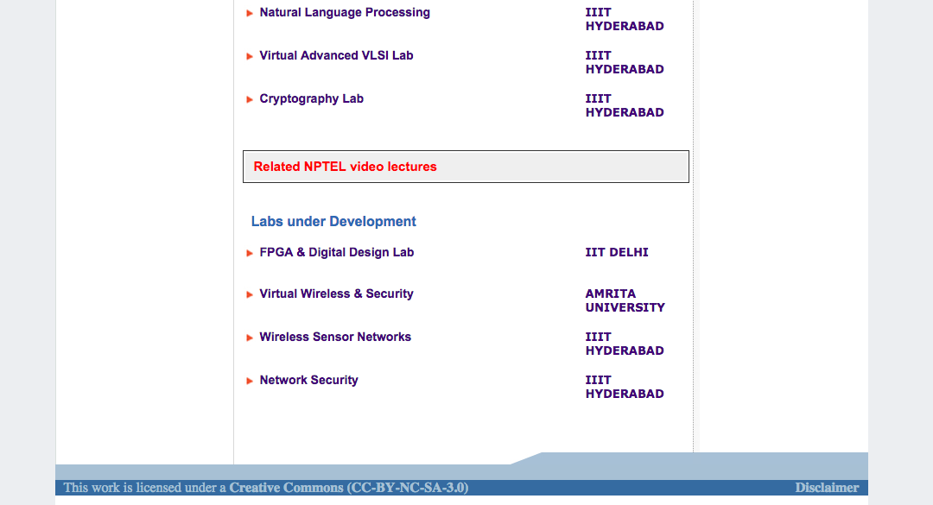
Usability Review of Virtual Labs
For a Learner
Related videos not shown in context
The relevant videos are not shown near the lab. User has to figure out relevant video on another page rather than getting the information in one place.
23

Slide 11
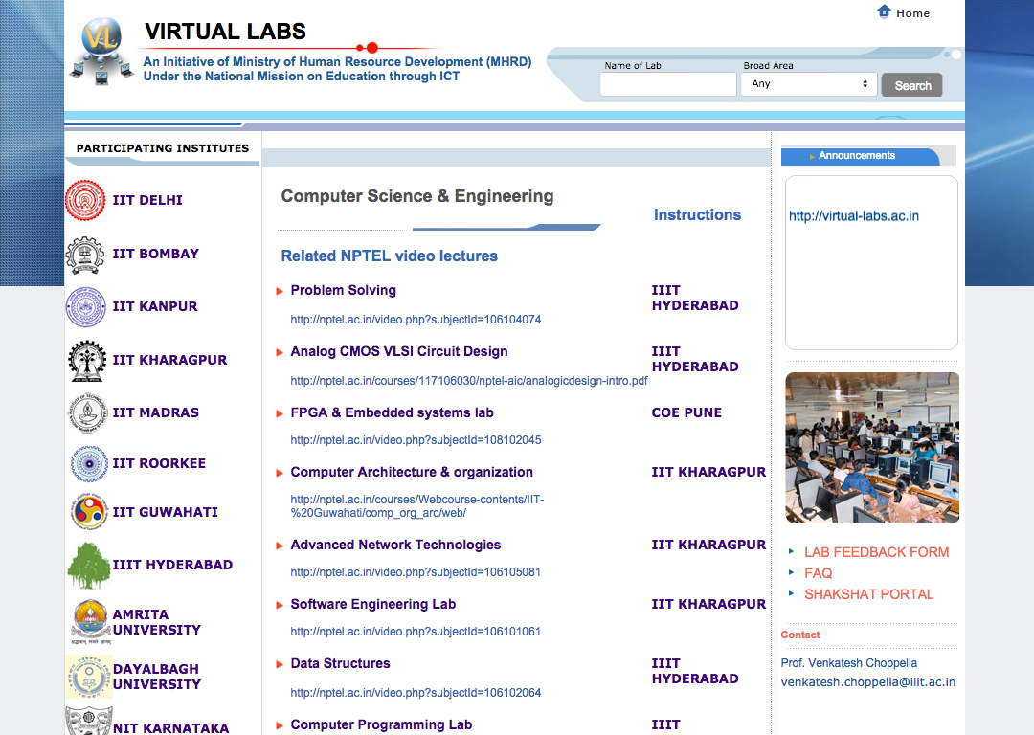
Usability Review of Virtual Labs
For a Learner
Video links lead to visual clutter
Shows a long http link address instead of clear play video button. Technical jargon causing visual clutter because of repeated occurrence of the links.
24

Slide 12
Usability Review of Virtual Labs
For a Stakeholder
Stakeholders: HRD Ministry & Participating Institutes
Goals:
To showcase the V labs initiative
To see the impact of V Labs (Students & Institutes)

Slide 13
Usability Review of Virtual Labs
For a Stakeholder
26
Impact missing
Fails to indicate the real value it brings to students and colleges.
27
What is this?
Objectives text is too dense and fails to convey clearly and quickly about V labs.
Labs reach missing
Fails to indicate the reach of the virtual labs and how students have been affected by using the virtual labs.
25
28
What do I do here?
Fails to show the core educational areas upfront

Slide 14
Usability Review of Virtual Labs
For a Stakeholder
29
Irrelevant announcements
Nothing useful and taking attention from the main content.
Clearly shows the collaborators of virtual labs indicating participation from the best institutes of India.

Slide 15
Usability Review of Virtual Labs
For a Stakeholder
Key statement of Philosophy missing upfront
A key statement that conveys the philosophy and roots of the initiative is missing.
30
31
Distracting moving images
Images cycle repeatedly distracting users away the main content
32
Distracting blinking link
‘Lab feedback form’ links keeps blinking, its adds another distraction away from the labs content.

Slide 16
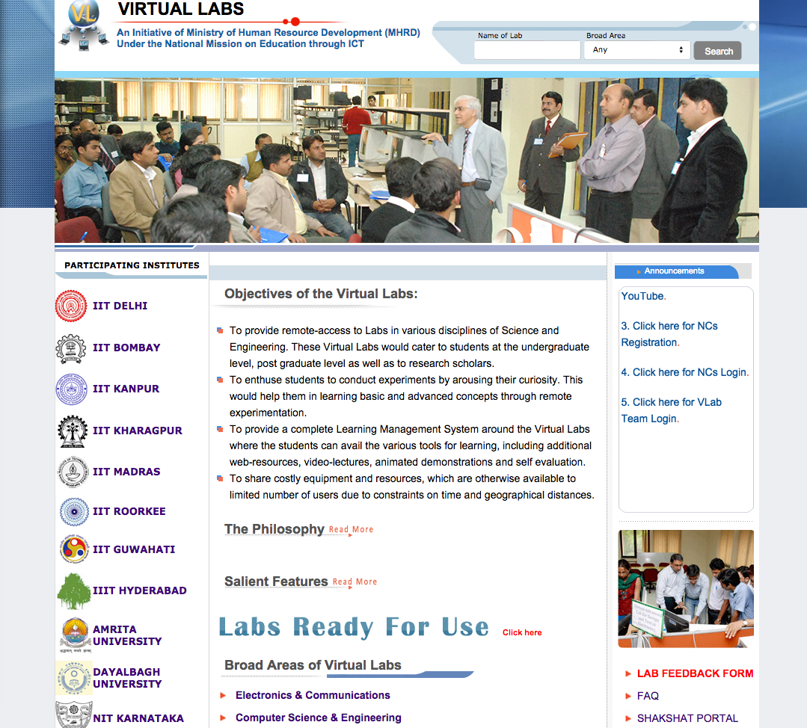
Usability Review of Virtual Labs
All Users
1
33
Colour overload
More than nine colours used on the page. It causes inconsistency and makes reading very difficult.
Inconsistent use of different fonts of varying sizes also leads to poor readability and affects the flow.
This also leads to confusing information hierarchy.

Slide 17
Usability Review of Virtual Labs
Design Recommendations
Student
Category and sub category of labs offered
Number of relevant labs (2,3,4th year)
Credibility of V labs
Objective and story of the initiative
Stakeholder
Impact of the V labs
Visibility of supporting educational community
Objective and story of the initiative
Key offering

